Slide 1

Enhancing Accommodation Selection for Broward County, Fl.
for airbnb through
Data Visualization.
Done by:
Harshan Ragavandar
Quang Nhut Ly
Muhammad Miqdad

Slide 2
Table of contents
01
02
03
Introduction
Visual Aids
Conclusion
04
data collection

Slide 3
01
Introduction

Slide 4
Introduction
In the realm of modern travel, the choice of accommodation holds immense importance, particularly in a sought-after destination like Broward County, Florida. Travelers increasingly prioritize a balance of comfort, affordability, and reliability in their lodging choices.
Our Data Visualization project specifically targets the challenges inherent in selecting accommodations within Broward County, including options available through Airbnb. By focusing on comprehensive data representation and analysis, we aim to transform this decision-making process.
.

Slide 5
02
Visual Aids

Slide 6
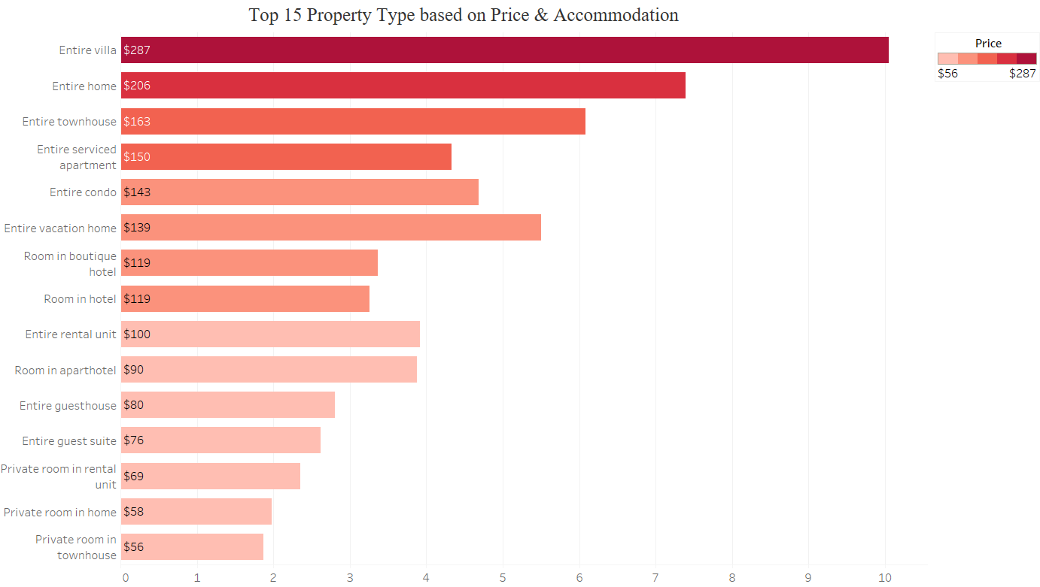
Top 15 “Property Type” based on Price & Accommodation
The graphs has used median of price to list the Top 15 results.

Slide 7
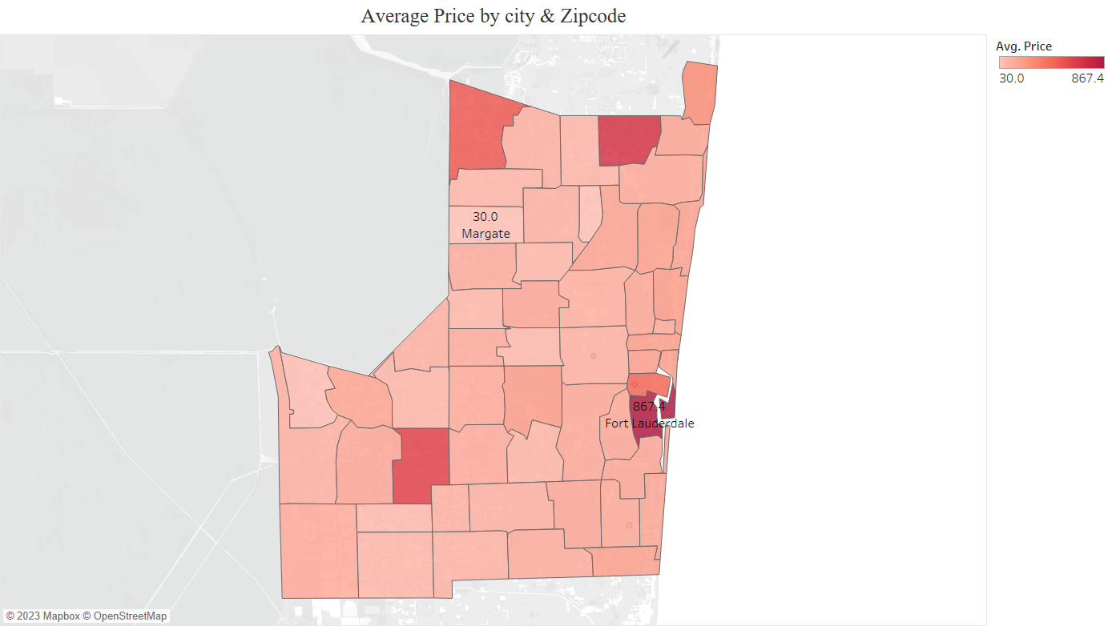
Average Price by city & Zip Code

Slide 8
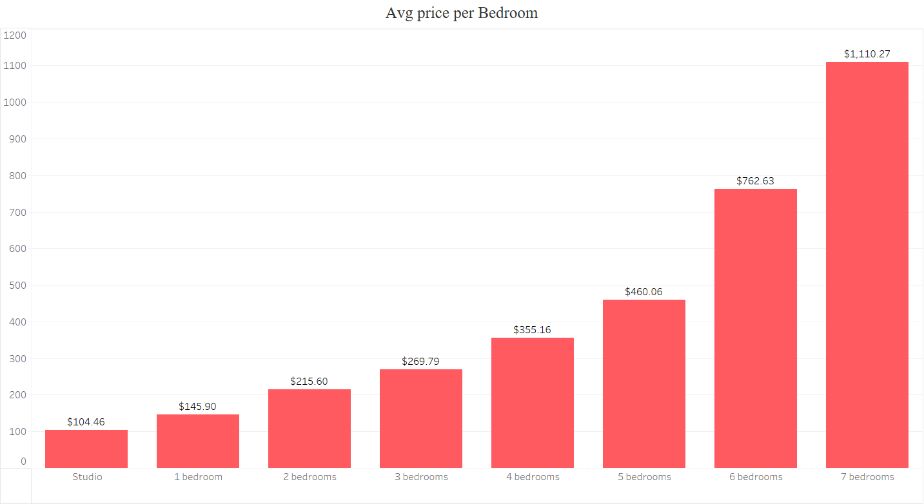
Avg Price per Bedroom

Slide 9
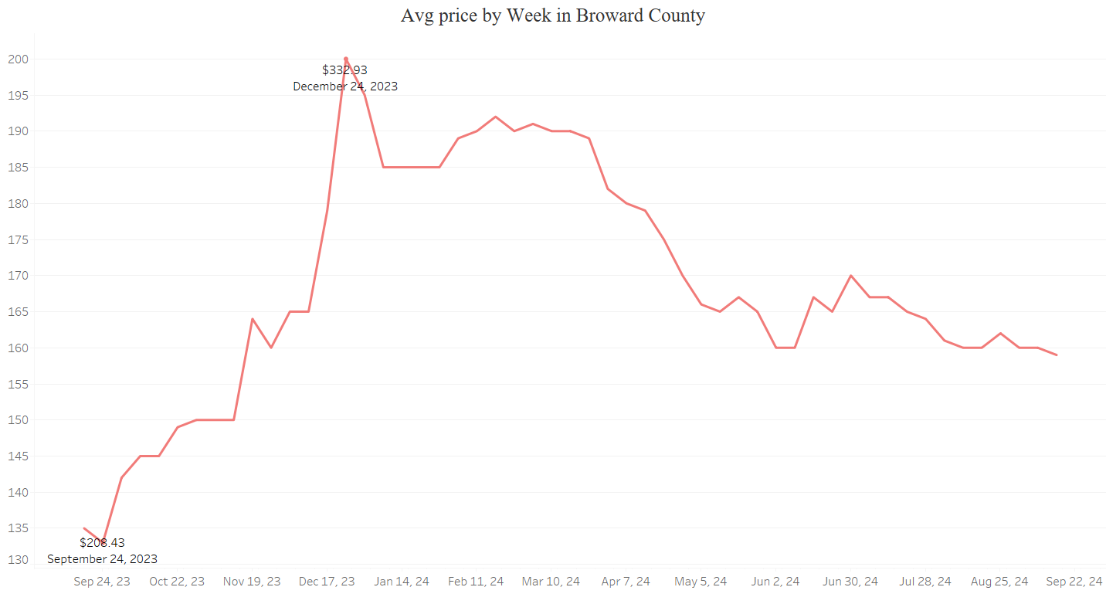
Avg Price by “Week” in Broward County

Slide 10
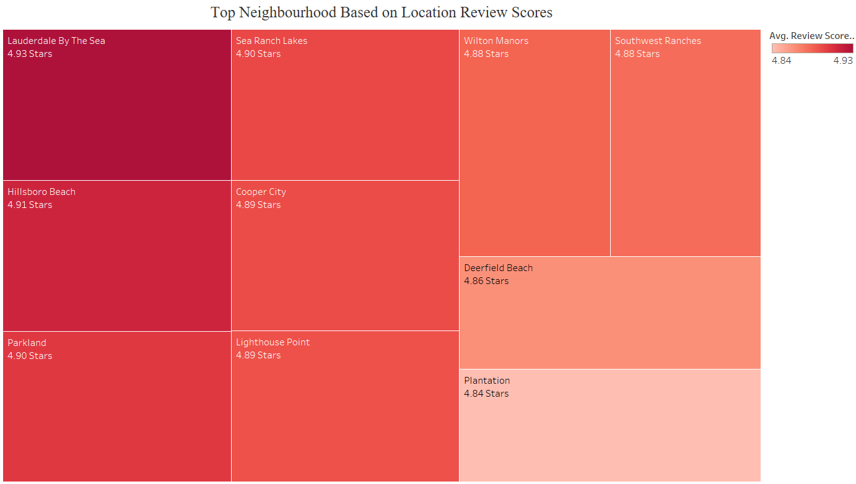
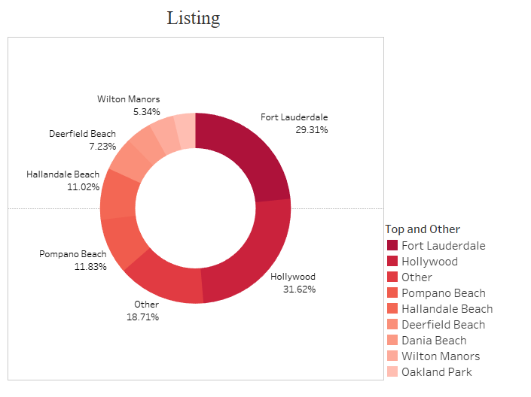
Top Cities Based on “Location Rating”
Cities with higher Accommodation density

Slide 11
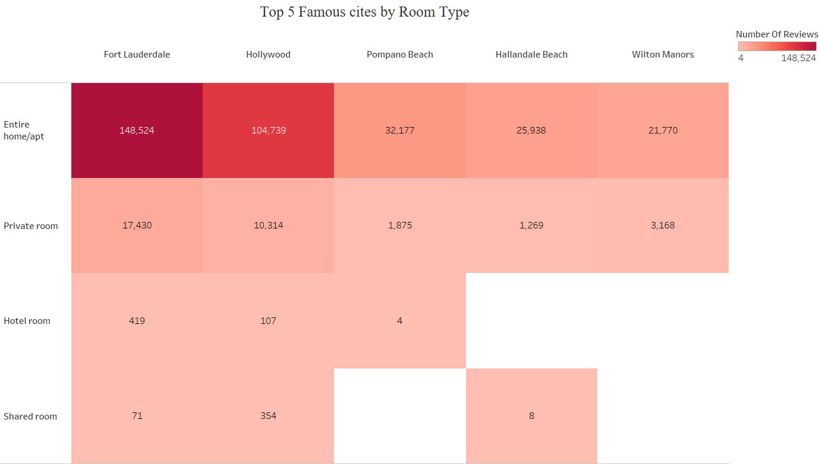
Top 5 Famous Cities by Room Type in Broward County

Slide 12
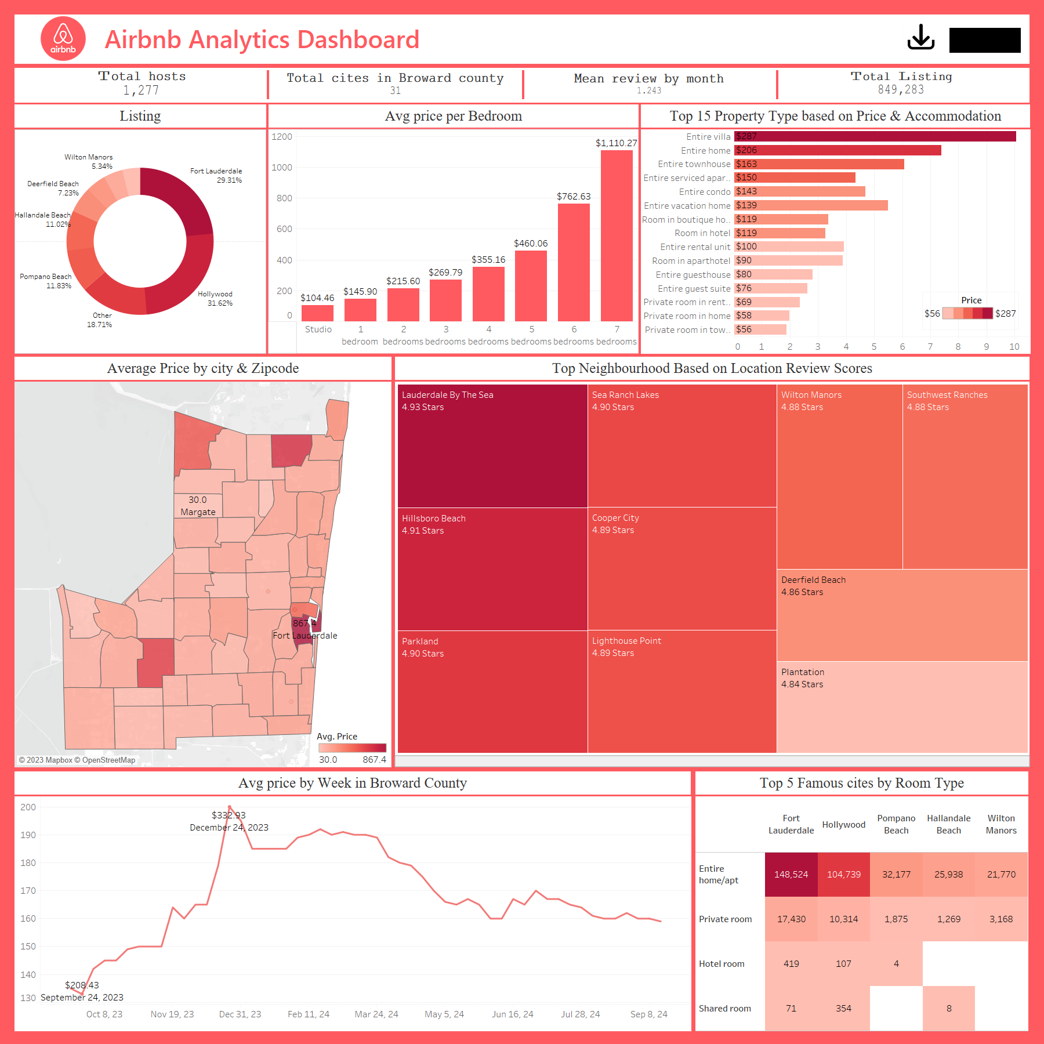
DASHBOARD

Slide 13
03
CONCLUSION

Slide 14
Conclusion
Our project streamlines vacation planning by aiding users in selecting accommodations based on various factors like price, reviews, and listings through an intuitive UI. The dashboard presents key insights: for instance, "Hollywood" boasts a high density of lodging options, ideal for spontaneous trips to Broward County with great deals due to its abundant listings.
We provide essential data such as the "Avg price per bedroom" to assist in budget planning effectively. Additionally, our platform showcases a dedicated graph allowing users to identify the optimal property type, such as an "Entire villa" priced at $287 per night for a group of 10 people.
Moreover, our project enables users to pinpoint the best-priced accommodations by zip code and city. For instance, the highest average price is in "Fort Lauderdale" at $876 per night, while the most affordable option averages at $30 per night in "Tamrac."
With these functionalities and more, our project serves as a comprehensive tool for selecting the ideal Airbnb in Broward County, FL, ensuring an optimal vacation experience.

Slide 15
Thanks!

